Slide 1

PASSWORD MANAGEMENT SYSTEM
.

Slide 2

Team members:
2110030020-Ch.Sri Chandana
2110030032-D.Neha
2110030056-B.Akshita
2110030457-V.Charishma
.
Under The Guidance Of:
Dr. Figlu Mohanty

Slide 3
PROBLEM STATEMENT AND DOMAIN:
Passwords are difficult to remember, and users have many accounts that require passwords. This causes users to choose memorable but weak passwords and then reuse them, which creates major security problems.
We propose a method for users to only need to remember one password that they use to access all their other passwords from any device at any time.
Its comes under Software Domain.

Slide 4
How it works:
Password management software is a utility you can use to save and retrieve all your passwords. This software could be a standalone application on your local computer or a feature within another application. This option greatly limits hackers' possible routes to your password data while adding convenient features for organizing and retrieving information.
The password manager generates a random number between 1 and 4 with help of FOR LOOP to choose the character set.
Once the set has been randomly selected a random index will be generated for the selected character set.

Slide 5
DATA SET COLLECTION:
All passwords are stored in a single database protected with a unique master password or a key file.
So, the key , is to keep the master password safe and protected as that will allow unlocking all the stored passwords in a database.
The password database is encrypted with AES and Two fish algorithms, so you know it’s secure.
Official download is available for Windows and portable.
However, many unofficial downloads are available for different platforms like Linux, Android, and Mac OSX.

Slide 6
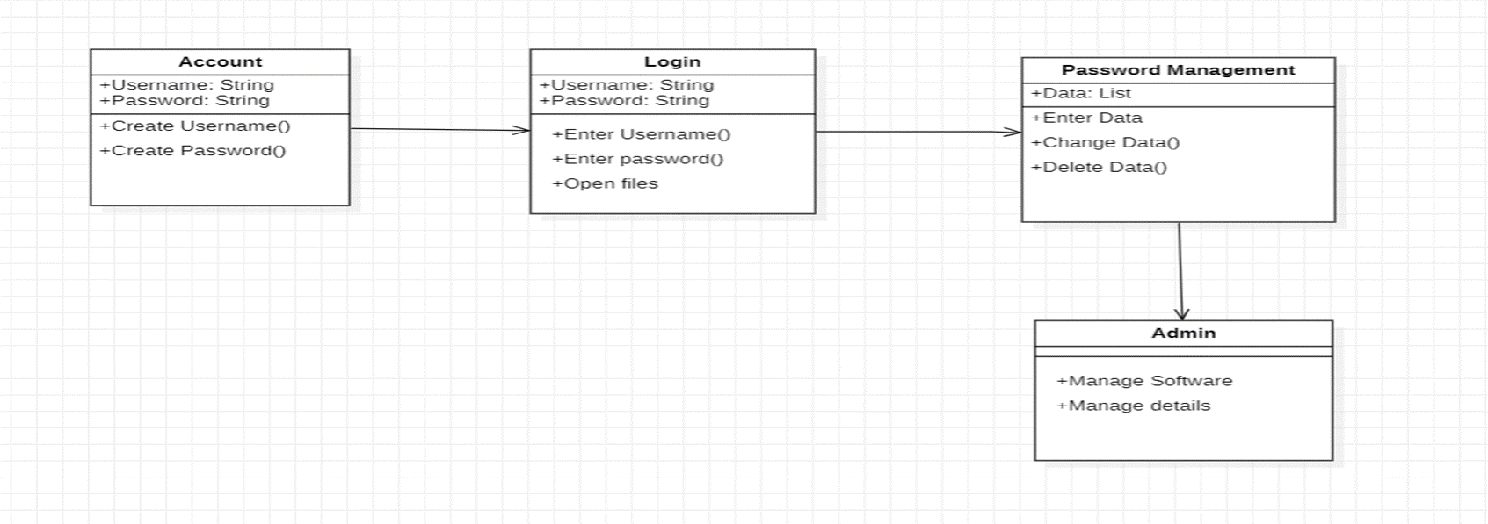
CLASS DIAGRAM :

Slide 7
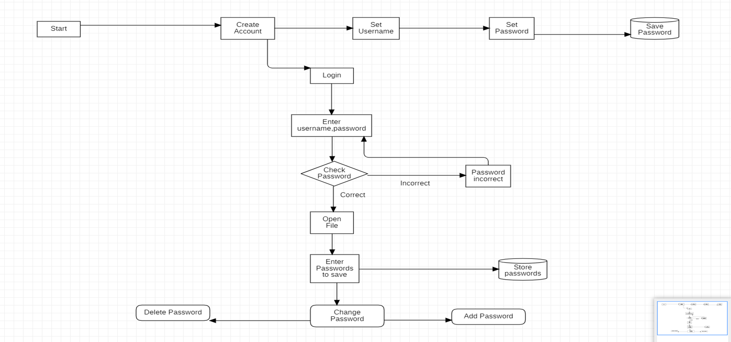
FLOW CHART:

Slide 8
TOOL SETUP:
Eclipse text editor-for editing the java code
Java Software- for running java code
Visual Studio code-for frontend
My SQL- for backend database development
Star UML- for data modelling diagrams

Slide 9
WORK PROGRESS:
We team members have:
Created a project outline.
Completed the research in important aspects of the project.
Information regarding the project development is collected
Started the front-end development.

Slide 10
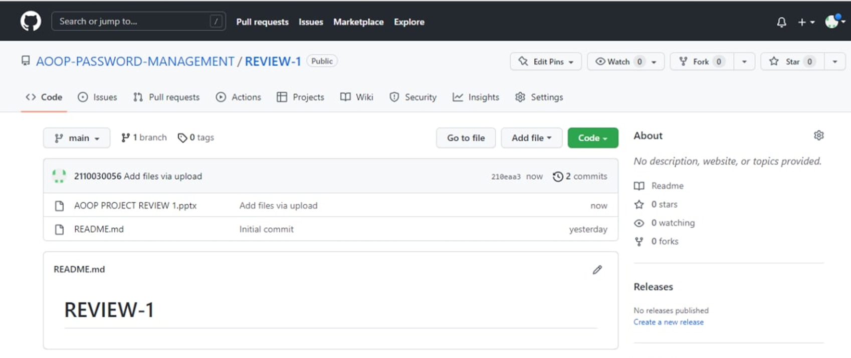
GIT HUB COMMITS:

Slide 11
TEAM CONTRIBUTION:
2110030020 - Ch.Sri Chandana- PPT
2110030032 - D.Neha- PPT
2110030457- V.Charishma- Information
2110030056-B.Akshita- Information

Slide 12

Thank You

